Slide 1
Precinct Officer
Information Session

Slide 2
Welcome
Jeffrey Rose
Chair

Slide 3
Goals for today
Run of Show
What we’ll cover
What we won’t
Ask questions but be respectful
Make space
Setting Expectations

Slide 4
A geographic area containing a certain number of voters
Smallest administrative electoral unit
Think election-day voting locations
Generally, everyone in a precinct has the same ballot and elected officials
What is a Precinct?

Slide 5
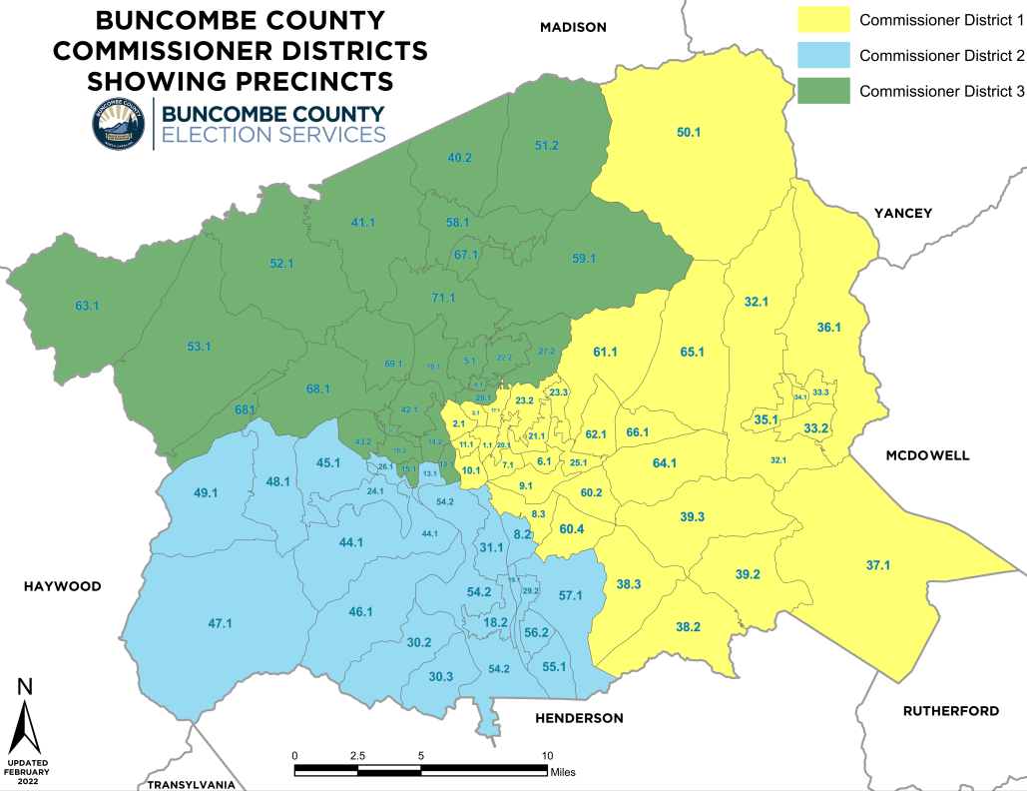
What is a Precinct?

Slide 6
At the state level
North Carolina Democratic Party
Allocates resources (people, technology) to counties/districts to win elections
County Parties
County Executive Committee (Precinct Officers!) provide direction and execute strategy
Participate in get out the vote and other electoral organizing
Clusters
Relatively unique feature of Buncombe’s structure
Buncombe has 11 and they coordinate regionally
How Your Precinct Fits In

Slide 7
Plan ways to get out the vote and organize
Most powerful level of Democratic Party
Organizes volunteers for election day
Recruit judges, observers, poll greeters
Direct community outreach
Provide input to county party and elect representatives to state and district levels
What does a precinct do?

Slide 8
Hold precinct meet and greet events to reach new members
Hand out sample ballots on election day
Canvass in newly built housing areas
Write postcards to new voters
Organize to oppose neighborhood development or support initiatives (yes, even issue based ones)
Register voters at neighborhood events
What does a precinct do?
(examples)

Slide 9
Work completely on their own
Support non-Democratic candidates
Work for external groups (non-profits, etc)
Support candidates in primaries
Gatekeep party resources on ideology
What are some things precincts shouldn’t do?

Slide 10
Brainstorm:
Ideas for your Precinct?

Slide 11
Officer Positions

Slide 12
Elected Chair, Vice Chair, and Secretary/Treasurer from each precinct
We’re all volunteers
Precinct officers are a cross-section of Buncombe Democrats
Motivated by a desire to make local change
Only requirement is to be a registered Dem
Who are Precinct Officers?

Slide 13
A positive attitude about political engagement
Taking time to learn your position (with help)
Being comfortable with email
Putting the precinct and members first
Able to listen and learning from others
Some free time
What makes a “Good” Precinct Officer?

Slide 14
Function as a three person team
Roles are flexible in practice, even if on paper they seem rigid
You are never alone!
Treat each other with grace and respect
Can’t be immediate family living together
Officers (General)

Slide 15
Establishes goals for the precinct
Leads execution of a voter outreach plan
Preside at precinct meetings
Recommend persons to serve as elections officials
Attend meetings of the county executive committee
Whatever else the precinct/county decides!
Precinct Chair

Slide 16
Preside at meetings in absence of the chair
Carry out other duties assigned by the county executive committee, or in lieu of the chair
Attend meetings of the county executive committee
Whatever else the precinct/county decides!
Precinct Vice Chair

Slide 17
Keep all records of the committee (think attendance/email lists/minutes)
Issue meeting notices to assist the chair if necessary
Prepare and file reports as necessary
Whatever else the precinct/county decides!
Precinct Secretary/Treasurer

Slide 18
Be respectful of others opinions and experiences, and expect the same
Our goal is a stronger party
Important party leadership roles - you must be willing to represent the whole precinct
Above all, have fun and elect Democrats
Officers, Continued

Slide 19
Questions?

